Slide 1
Introduction to the Generic Names Supporting Organization (GNSO) & Policy Development

Slide 2
Agenda
1
2
3
Policy Development at ICANN
The GNSO and the GNSO Council
GNSO Policy Development Process
4
5
6
Engagement with other SO/ACs
A case study: new gTLD Subsequent Procedures PDP
Questions & Answers
Notes:
This is a stylized agenda slide for your presentation.
To delete a box, if there are too many boxes, click the edge of the box, ensure the entire box is highlighted, then DELETE.
To update the numbers and text, click inside the circle for the numbers or in the box for the text, revise the text.
<number>

Slide 3
How GNSO policy development differs from other SO policy development

Slide 4
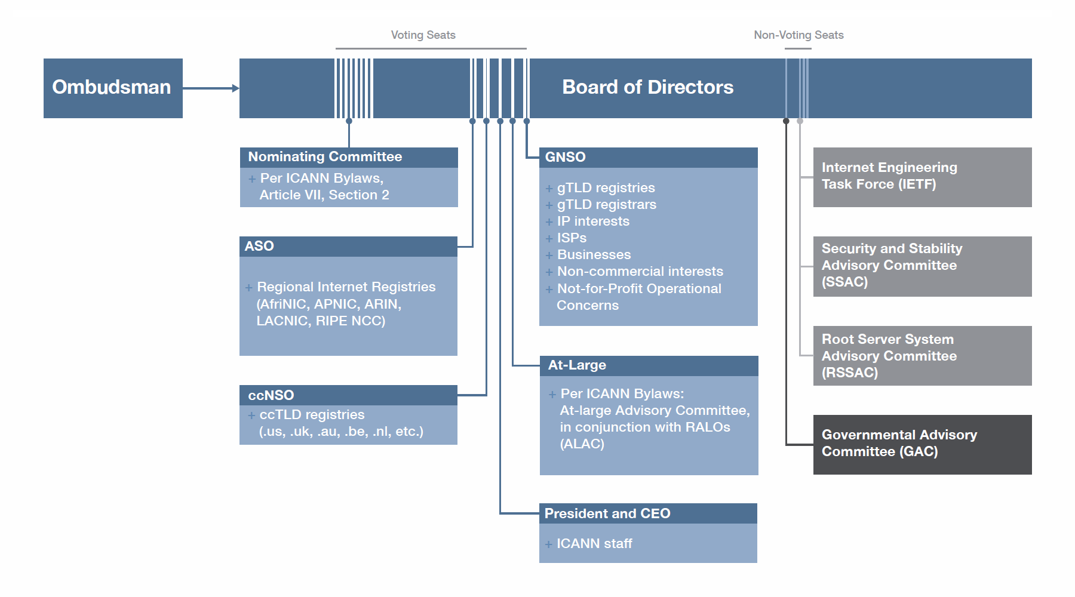
ICANN Multi-Stakeholder Model
Advisory Committees

Slide 5
ICANN Multi-Stakeholder Model
Supporting Organizations

Slide 6
The GNSO and the GNSO Council

Slide 7
The GNSO and the GNSO Council
Generic Names Supporting Organization
GNSO is responsible for policy development related to generic Top Level Domain (e.g., .com, .net, .info, .amsterdam, .app)
21 Councilors from 6 different Constituencies / Stakeholder Groups & Nom Com appointees

Slide 8
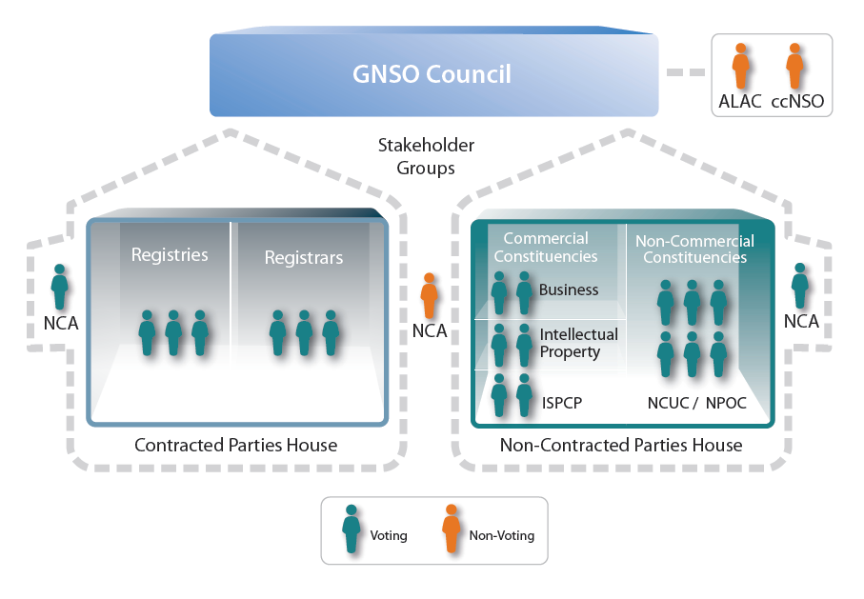
The GNSO Council Structure
Council voting happens at the house level to ensure parity between the contracted and non-contracted party house, despite a different # of Council representatives
17
Notes:
Quick overview
<number>

Slide 9
GNSO Policy Development Process (the “PDP”)

Slide 10
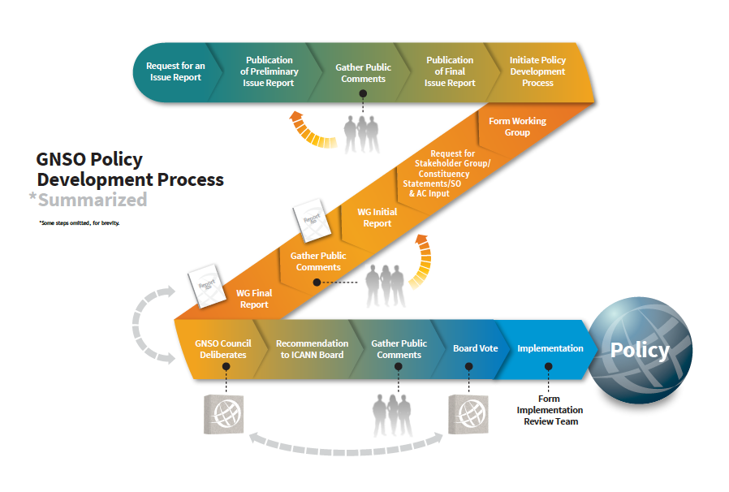
GNSO Policy Development Process

Slide 11
What is ICANN “Consensus Policy”?
All ICANN-accredited registrars and registries have contracts with ICANN that contain binding legal obligations: http://www.icann.org/en/general/agreements.htm
In this context, “Consensus Policy”* is a policy broadly supported by ICANN’s stakeholders, and which can bind ICANN-accredited registrars and registries
Please refer to particular contracts for specific limitations and to the ICANN Bylaws for the overall context. Note that this presentation does not not constitute legal advice or a waiver or modification of any ICANN agreement
1

Slide 12
“Consensus Policy”
In their contracts with ICANN, registries and registrars agree to comply with “consensus” policies adopted by ICANN; provided that (i) such policies do not unreasonably restrain competition; and
(ii) the policies relate to:
Issues for which uniform or coordinated resolution is reasonably necessary to facilitate interoperability, technical reliability and/or stable operation of the Internet or Domain Name System;
Registry / registrar policies reasonably necessary to implement Consensus Policies relating to registrars/registries; and
Resolution of disputes regarding the registration of domain names (as opposed to the use of such domain names)
Detailed topics subjected to “Consensus Policy” are also further defined in the gTLD Registry and Registrar Agreements
Notes:
<number>

Slide 13
“The Picket Fence”
The general policy making authority granted to ICANN to preserve the stability and security of the DNS and the policy authority described in previous slide create a “picket fence” around ICANN’s authority
ICANN could establish policy and/or best practices affecting issues outside the picket fence, but could not mandate registry and registrar compliance with such policies. Issues considered outside of the picket fence include, for example, pricing.

Slide 14
Important facts about participation
Anyone can participate in a GNSO PDP Working Group, if that is the chosen model for the PDP Team
Anyone can join a Working Group as a Member or Observer
Participation in a GNSO Working Group currently remains open throughout the lifecycle of the project
Much policy development work occurs regularly throughout the year, not just at ICANN meetings
Although attending an ICANN meeting is useful, all Working Groups conduct their work via conference calls, mailing lists and virtual meeting rooms

Slide 15
PDP 3.0
GNSO Council is currently considering incremental improvements to the PDP to enhance efficiency and effectiveness of GNSO policy development activities. Improvements are focusing on the following areas:
Working Group dynamics
Working Group leadership
Complexity of subject matter
Consensus building
Role of the Council as the manager of the PDP

Slide 16
Engagement with other SO/ACs

Slide 17
Engagement with other SO/ACs
The GNSO Council has a liaison FROM the ALAC and the ccNSO as well as a liaison TO the GAC and the ccNSO, as well as joint meetings with the ccNSO and GAC at ICANN meetings.
Numerous opportunities for SO/ACs to provide input to the PDP process, e.g. specific input requested at an early stage of the process as well as various opportunities for public comment
Specific mechanisms created to facilitate early engagement by the GAC in policy development mechanisms as a result of the GAC-GNSO Consultation Group, including the Quick Look Mechanism to identify whether or not a PDP is expected to raise public policy concerns.
None of these engagement opportunities negate other SO/ACs’ performance of their role as described under the Bylaws.

Slide 18
Where to find more information
Sign up for the various ICANN regional newsletters to get news about selected policy work, current public comment opportunities and upcoming webinars
Sign up for the Policy Update webinars, scheduled before each ICANN meeting
Check out the GNSO web-site for further information: http://gnso.icann.org

Slide 19
Questions & Answers

Slide 20
A Case Study: new gTLD Subsequent Procedures PDP

Slide 21
What is the PDP about?
GNSO recommendations from 2007 resulted in the Applicant Guidebook and the 2012 round of the New gTLD Program.
The New gTLD Subsequent Procedures PDP (“SubPro”) is focused on considering the 2012 round policy and determining what changes might need to be made to the original GNSO recommendations from 2007.
The PDP was chartered and began its work in early 2016
Charter available here: https://gnso.icann.org/en/issues/new-gtlds/subsequent-procedures-charter-21jan16-en.pdf

Slide 22
How is the PDP Structured?
The PDP has two overall co-chairs: Jeff Neuman and Cheryl Langdon-Orr
The PDP has over 40 separate topics identified in its charter and broke into sub team work tracks to tackle work:
Work Track 1: Overall Process/Support/Outreach (Christa Taylor and Sara Bockey)
Work Track 2: Legal/Regulatory (Michael Flemming and Sophia Feng)
Work Track 3: String Contention, Objections, Disputes (Karen Day and Robin Gross)
Work Track 4: IDNs, Technical & Operations (Rubens Kuhl and Cheryl Langdon-Orr)
Work Track 5: Geographic Names at the Top-Level (Annebeth Lange, Javier Rúa-Jovet, Martin Sutton, and Olga Cavalli)
All Work Tracks will submit their work to the whole WG for review and approval

Slide 23
What is the Role of the PDP Leadership?
Serving as a leader in this PDP, and any other GNSO PDP, is more about ensuring process is followed, including scheduling meetings, presiding over those meetings, ensuring PDP members are able to provide their contributions, and to deliver the WG’s results to the GNSO Council.
The overall WG co-chairs come from the GNSO and ALAC, while Work Track 5 has co-leads from each of the ALAC, ccNSO, GAC, and GNSO. However, as noted, the role of leadership is about ensuring debates take place in an open and transparent fashion and that different viewpoints are able to be shared, and not serving as advocates for their particular position or that of their organization.

Slide 24
Who Can Participate?
Anybody is welcome to participate, as long as they complete a Statement of Interest.
The overall PDP has ~180 members and ~80 observers, with participation from ALAC, ccNSO, GAC, individuals, and all GNSO Stakeholder Groups/Constituencies
Work Tracks 1-4 have ~40-60 members, also with broad representation
Work Track 5 has ~155 members and ~90 observers, including 24 members from the GAC

Slide 25
How Does the PDP Operate?
Most of the PDP’s work takes place during conference calls with members (every week or every other week)
However, the PDP convenes for face-to-face sessions at ICANN meetings, discussing issues with the wider community
The PDP tracks its work in a number of ways, with everything available on the dedicated Wiki space (https://community.icann.org/x/RgV1Aw):
Recordings, transcripts (for full WG), and notes from all meetings
Working documents used to capture deliberations
Data requests, background materials, and other inputs
Among other things, the Wiki also includes attendance records for all meetings, the PDP’s work plan, action items, etc.

Slide 26
How Does the PDP Engage With the Community?
Early Engagement with the GAC
Request for past/existing Advice and Statements from SO/AC/SG/Cs
Monthly Newsletters
Community Comment 1 (on overarching issues)
Community Comment 2 (the rest of the charter topics, via direct outreach and published for public comment)
At ICANN Meetings:
Face-to-face working sessions
Cross-community sessions
Direct engagement with community groups (e.g., ALAC, GAC) on topics of particular interest

Slide 27
PDP 3.0 – Example of Some Practices in Place
Re-establishing the relationship with GNSO Council liaisons to the PDP - for the SubPro PDP, there are two (Donna Austin and Keith Drazek).
Participation in leadership coordination and planning meetings
Working towards deadlines and making sure Council liaisons are informed
After the Initial Report is published and the WG works towards its Final Report, additional practices may be needed:
May need to divide the content into “chunks” to be able to make progress on the large amount of content
Getting to consensus will require effective listening and leadership
Strong adherence to a work plan

Slide 28
What is Coming Next for the PDP?
Will publish Initial Report on Work Tracks 1-4 for public comment
Then, consider public comment on Initial Report and work towards completion and delivery of Final Report to GNSO Council for its consideration.
Engage with the community at ICANN62, including cross community sessions on geographic names at the top-level
Will publish a separate Initial Report on just geographic names at the top-level

Slide 29
What Happens After the PDP delivers its Final Report?
This PDP is seeking to deliver its Final Report to the GNSO Council in early 2019.
From that point, these are some of the expected next steps (as with the conclusion of any PDP):
GNSO Council consideration and adoption of the PDP recommendations in the Final Report
Council report to Board / Public Comment
ICANN Board consideration and adoption of the PDP recommendations as adopted by GNSO Council
ICANN org (as directed by the Board) to begin implementation of the PDP recommendations (which will likely include a revised Applicant Guidebook)

Slide 30
PDP Resources
Active Project Page: https://gnso.icann.org/en/group-activities/active/new-gtld-subsequent-procedures
PDP Wiki: https://community.icann.org/x/RgV1Aw
PDP Mailing List Archive: http://mm.icann.org/pipermail/gnso-newgtld-wg/
Newsletters: https://gnso.icann.org/en/news/working-group-newsletters
Pre ICANN Meeting GNSO Policy Briefings: http://go.icann.org/policybriefing
Archive: https://gnso.icann.org/en/issues/background-briefings/archive

Slide 31
Questions & Answers

